Slide 1
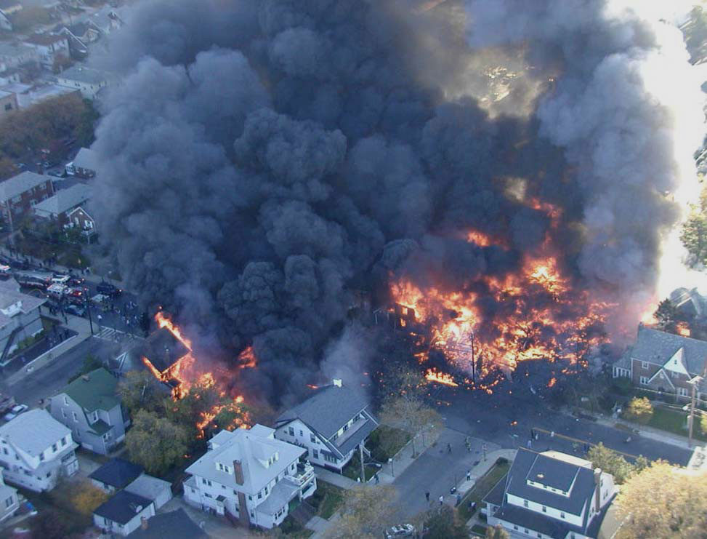
Home
Check a short video and how to add it
Aviation Summary
<p What:
Evaluate aviation accidents and incidents in the last 20 years at global level./p>
<p Why:
Pellentesque habitant morbi tristique senectus et netus et malesuada fames ac turpis egestas. Vestibulum tortor quam,.
/p>
American Airlines Flight 587 was a regularly scheduled international passenger flight from John F. Kennedy International Airport to Las Américas International Airport in Santo Domingo, the capital of the Dominican Republic Nov 12 2001
Team Members
Daniel Murchison
Edith Jimenez Mendez
Jin Dai
Michael Gonzalez
Mike Sammis
Write some statement about worst event
xxx
xxx
xxx
Aviation Events

Slide 2
Location
Time
About
Tell a summary of our finding about Aviation Events
Pellentesque habitant morbi tristique senectus et netus et malesuada fames ac turpis egestas. Vestibulum tortor quam, feugiat vitae, ultricies eget, tempor sit amet, ante. Donec eu libero sit amet quam egestas semper. Aenean ultricies mi vitae est. Mauris placerat eleifend leo.
Time_Keeps_On_Ticking
Capture from Leaflet hw

Slide 3
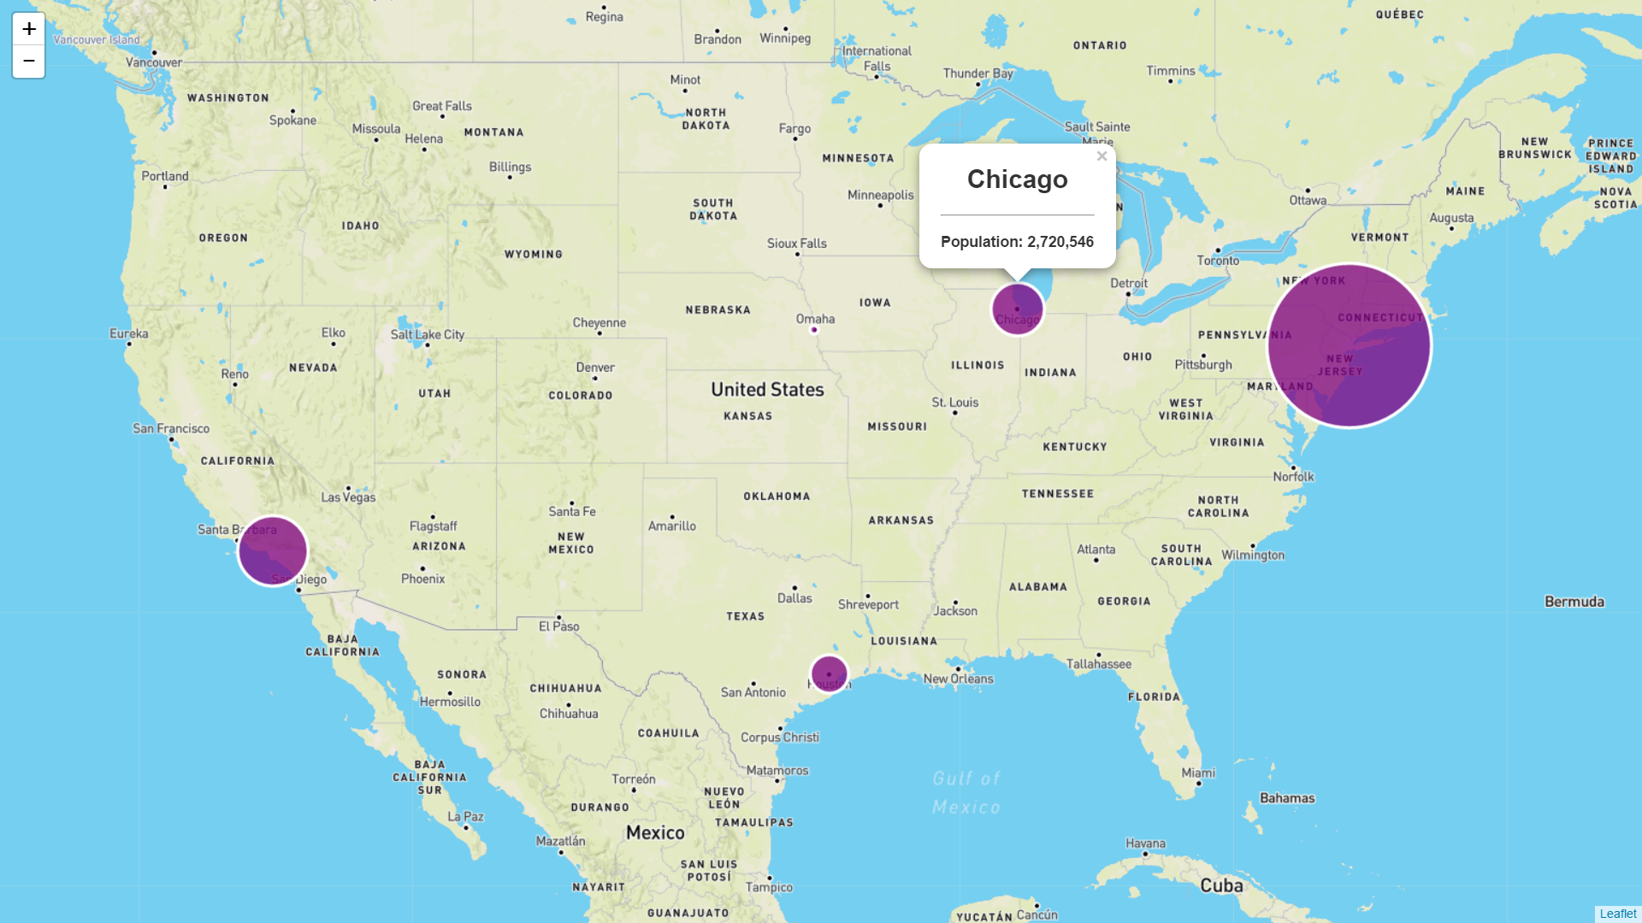
Location
Time
About
Select Country
Drop down
Country map with markers show the accident city lat&long
Different types of injuries each year by country
Tell story about the results of this graph
tristique senectus et netus et malesuada fames ac turpis egestas. Vestibulum tortor quam, feugiat vitae, ultricies eget, tempor sit amet, ante. Donec eu libero sit amet quam egestas semper. Aenean ultricies mi vitae est. Mauris placerat eleifend leo.
Tell story about the results of this graph
tristique senectus et netus et malesuada fames ac turpis egestas. Vestibulum tortor quam, feugiat vitae, ultricies eget, tempor sit amet, ante. Donec eu libero sit amet quam egestas semper. Aenean ultricies mi vitae est. Mauris placerat eleifend leo.

Slide 4
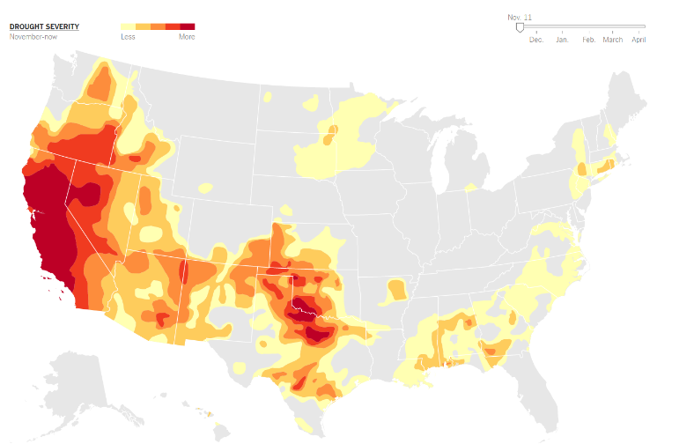
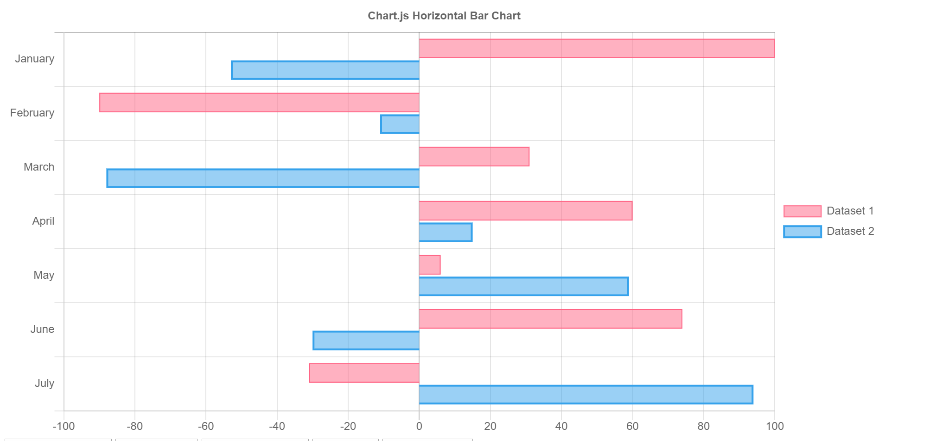
Location
Time
About
Accident Year
Drop down
Global heat map accident by year
Bar chart of different type of injuries by year by month globally ( New JS library, chart.js) Need to be discusses
Tell story about the results of this graph
tristique senectus et netus et malesuada fames ac turpis egestas. Vestibulum tortor quam, feugiat vitae, ultricies eget, tempor sit amet, ante. Donec eu libero sit amet quam egestas semper. Aenean ultricies mi vitae est. Mauris placerat eleifend leo.
Tell story about the results of this graph
tristique senectus et netus et malesuada fames ac turpis egestas. Vestibulum tortor quam, feugiat vitae, ultricies eget, tempor sit amet, ante. Donec eu libero sit amet quam egestas semper. Aenean ultricies mi vitae est. Mauris placerat eleifend leo.
Aviation Events

Slide 5
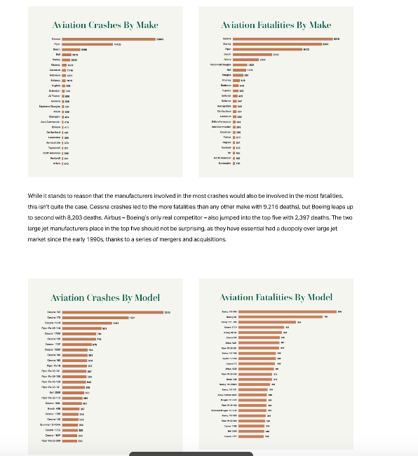
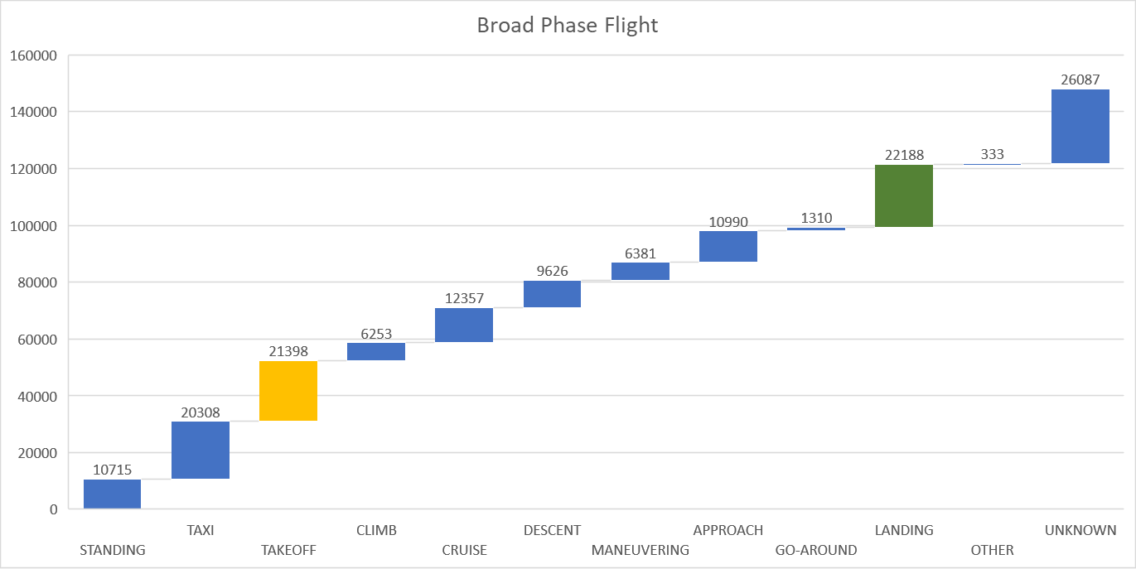
Location
Time
About
Aviation accident by make an model bar charts
Waterfall chart for Broad phase flight versus total injuries
Total Injuries = Total_Minor_Injuries + Total_Serious_Injuries + Total_Fatal_Injuries
Tell story about the results of this graph
tristique senectus et netus et malesuada fames ac turpis egestas. Vestibulum tortor quam, feugiat vitae, ultricies eget, tempor sit amet, ante. Donec eu libero sit amet quam egestas semper. Aenean ultricies mi vitae est. Mauris placerat eleifend leo.
Tell story about the results of this graph
tristique senectus et netus et malesuada fames ac turpis egestas. Vestibulum tortor quam, feugiat vitae, ultricies eget, tempor sit amet, ante. Donec eu libero sit amet quam egestas semper. Aenean ultricies mi vitae est. Mauris placerat eleifend leo.

Slide 6
END
Aviation Events

Slide 7
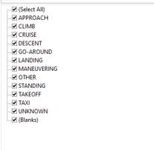
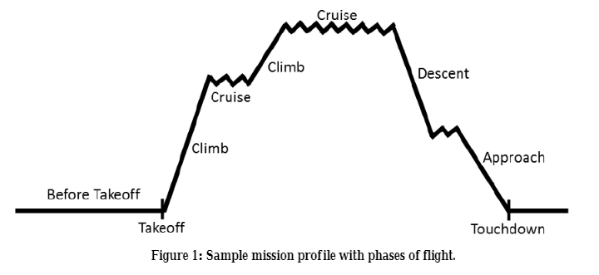
Write Notes Here
visual meteorological conditions (VMC)
instrument flight meteorological conditions (IMC)
Sequence of Broad Phase of Flight:
Standing (STD)
Pushback/Towing(PBT)
Taxi(TXI)
Takeoff(TOF)
Initial Climb(ICL) --- 1000ft
En Route (ENR)
- Climb to cruise
- Cruise
- Change Cruise level
- Descent
- Holding
Maneuvering (MNV)
Approach(APR)
- Missed approach → Go Around
Landing(LDG)
Unknown(UNK)
Broad Phase of Flight

Slide 8
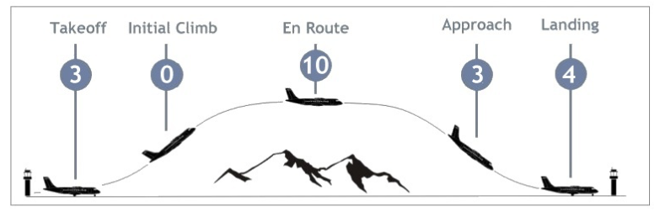
Chart – Event by Broad Phase of flight
Chart
Map
Data
What’s New
Total Event
Build a dropdown menu to select phase??? I am not sure about this drop down menu
Phases
Cruise

Slide 9
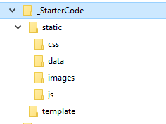
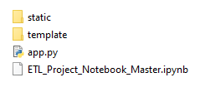


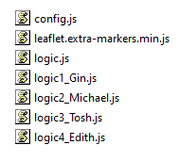
File_Structure
Flask
ETL Jupyter
Aviation Events

